Slide 1
OPERATING SYSTEMS
Razi Uddin
Lecture # 28

Slide 2


Deadlock Problem
A set of blocked processes each holding a resource and waiting to acquire a resource held by another process in the set.
--Examples:
System has 2 tape drives. P1 and P2 each hold one tape drive and each needs another one.
Another deadlock situation can occur when the poor use of semaphores,
The following code snippets show how a situation can arise where P0 holds semaphore A, P1 holds semaphore B, and both wait for the other semaphore—a typical deadlock situation.
Semaphore A,B=1
P0 P1
wait (A); wait(B);
wait (B); wait(A);

Slide 3
System Model
A system consists of a finite number of resources to be distributed among a finite number of cooperating processes.
The resources are partitioned into several types, each of which consists of some number of identical instances.
Memory space, CPU cycles, disk drive, file are examples of resource types.
A system with two identical tape drives is said to have two instances of the resource type disk drive.
If a process requests an instance of a resource type, the allocation of any instance of that type will satisfy the request.
If it will not, then the instances are not identical and the resource type classes have not been defined properly.
A process must request a resource before using it, and must release the resource after using it.
A process may request as many resources as it requires in order to carryout its designated task.
the number of resources requested may not exceed the total number of resources available in the system.

Slide 4
System Model
Request: The process requests a needed resource. If the request cannot be granted immediately, then the requesting process must wait until it can acquire the resource.
Use: The process can use the resource.
Release: The process releases the resource.

Slide 5
Deadlock Characterization
Mutual exclusion: At least one resource must be held in a non-sharable mode; that is only one process at a time can use the resource. If another process requests that resource, the requesting process must be delayed until the resource has been released.
Hold and wait: A process must be holding at least one resource and waiting to acquire additional resources that are currently being held by other processes.
No preemption: Resources cannot be preempted. That is, after using it a process releases a resource only voluntarily.
Circular wait: A set {P0, P1… Pn} of waiting processes must exist such that P0 is waiting for a resource that is held by P1, P1 is waiting for a resource that is held by P2, and so on, Pn-1 is waiting for a resource held by Pn, and Pn is waiting for a resource held by P0.

Slide 6
Resource Allocation Graphs
This graph consists of a set of vertices V and a set of edges E.
The set of vertices is portioned into two different types of nodes P={P0, P1… Pn}, the set of the active processes in the system, and R={R0, R1… Rn}, the set consisting of all resource types in the system.
A directed edge from a process Pi to resource type Rj signifies that process Pi requested an instance of Rj and is waiting for that resource.
A directed edge from Rj to Pi signifies that an instance of Rj has been allocated to P

Slide 7
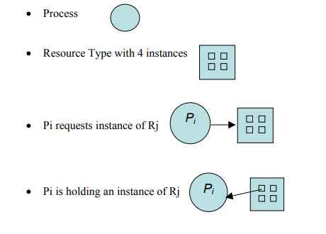
Resource Allocation Graphs
We will use the following symbols in a resource allocation graph.

Slide 8
Resource Allocation Graphs
P={P1, P2, P3 }
R={R1, R2, R3}
E={P1 → R1, P2 → R3, R1 → P2, R2 → P2, R2 → P1, P3 → R3}
Process States
Process P1 is holding an instance of resource R2, and is waiting for an instance of resource R1.
Process P2 is holding an instance of resource R1 and R2, and is waiting for an instance of resource R3.
Process P3 is holding an instance of resource R3.

Slide 9
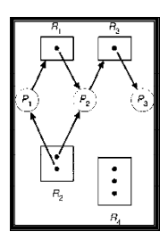
Resource Allocation Graphs
Given the definition of a resource allocation graph, it can be shown that if the graph contains no cycles, then no process is deadlocked.
If the graph contains cycles then:
If only one instance per resource type, then a deadlock exists.
If several instances per resource type, possibility of deadlock exists.

Slide 10
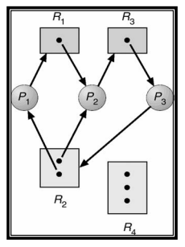
Resource Allocation Graphs
Here is a resource allocation graph with a deadlock.
There are two cycles in this graph:
{P1 → R1, R1 → P2, P2 → R3, R3 → P3, P3 → R2, R2 → P1} and
{P2 → R3, R3 → P3, P3 → R2, R2 → P2}
No process will release an already acquired resource and the three processes will remain in the deadlock state.

Slide 11
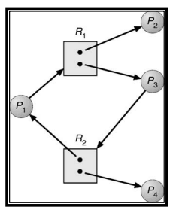
Resource Allocation Graphs
This graph has a cycle but there is no deadlock because processes P2 and P4 do not require further resources to complete their execution and will release the resources they are currently hold in finite time.
These resources can then be allocated to P1 and P3 for them to resume their execution.

Slide 12
Deadlock Handling
These three ways result in the following general methods of handling deadlocks:
Deadlock Prevention: is a set of methods for ensuring that at least one of the necessary conditions cannot hold. These methods prevent deadlocks by constraining how processes can request for resources.
Deadlock Avoidance: This method of handling deadlocks requires that processes give advance additional information concerning which resources they will request and use during their lifetimes. With this information, it may be decided whether a process should wait or not.
Allowing Deadlocks and Recovering: One method is to allow the system to enter a deadlocked state, detect it, and recover.

Slide 13
Deadlock Prevention
By ensuring that one of the four necessary conditions for a deadlock does not occur, we may prevent a deadlock.
Mutual exclusion
Hold and Wait
No preemption
Circular Wait

Slide 14
Deadlock Prevention
Mutual exclusion :
The mutual exclusion condition must hold for non-sharable resources, e.g., printer.
Sharable resources do not require mutually exclusive access and thus cannot be involved in a deadlock, e.g., read-only files.
Also, resources whose states can be saved and restored can be shared, such as a CPU.
In general, we cannot prevent deadlocks by denying the mutual exclusion condition, as some resources are intrinsically non-sharable.

Slide 15
Deadlock Prevention
Hold and Wait: To ensure that the hold and wait condition does not occur in a system, we must guarantee that whenever a process requests a resource, it does not hold any other resources.
One protocol that can be used requires each process to request and be allocated all its resources before it begins execution.
We can implement this provision by requiring that system calls requesting resources for a process precede all other system calls.
An alternative protocol requires a process to request resources only when it has none.
A process may request some resources and use them.
But it must release these before requesting more resources.
The two main disadvantages of these protocols are:
Firstly, resource utilization may be low, since many resources may be allocated but unused for a long time.
Secondly, starvation is possible. A process that needs several popular resources may have to wait indefinitely, because at least one of the resources that it needs is always allocated to some other process.

Slide 16
Deadlock Prevention
No preemption:
To ensure that this condition does not hold we may use the protocol:
if a process is holding some resources and requests another that cannot be allocated immediately to it, then all resources currently being held by the process are preempted.
These resources are implicitly released, and added to the list of resources for which the process is waiting.
The process will be restarted when it gets all its old, as well as the newly requested resources.

Slide 17
Deadlock Prevention
Circular Wait:
One way to ensure that this condition never holds is to impose a total ordering of all resource types, and to require that each process requests resources in an increasing ordering of enumeration.
Let R={ R1, R2, R3 }be resource types.
We assign to each a unique integer, which allows us to compare two resources and to determine whether one precedes another in our ordering.
For example, if the set of resource types R includes tape drivers, disk drives, and printers then the function F: R→N might be used to assign positive integers to these resources as follows:
F(tape drive) =1
F(disk drive) =5
F(printer)=12

Slide 18
Deadlock Prevention
Each process can request resources in an increasing order of enumeration.
For example, a process wanting to use the tape and the disk drive must first request the tape drive and then the disk drive.
We can prove that if processes use this protocol then circular wait can never occur.
We will prove this by contradiction.
Let’s assume that there is a cycle involving process P0 through Pk and that Pi is holding an instance of Ri, as shown below.
The proof follows.
P0 → P1 → P2 → … → Pk → P0
R0 R1 R2 Rk R0
⇒ F(R0) < F(R1) < … < F(Rk) < F(R0)
⇒ F(R0) < F(R0), which is impossible
⇒ There can be no circular wait.

